Slide 1
Denoise-EdgeDetect Filter
組別: 第四組
組員: 周聖平、蔡以心、張煒侖、李承澔

Slide 2
Agenda
Catapult HLS
Integrate into FSIC
Caravel-FSIC FPGA simulation
Synopsys flow
Caravel-FSIC FPGA validation

Slide 3
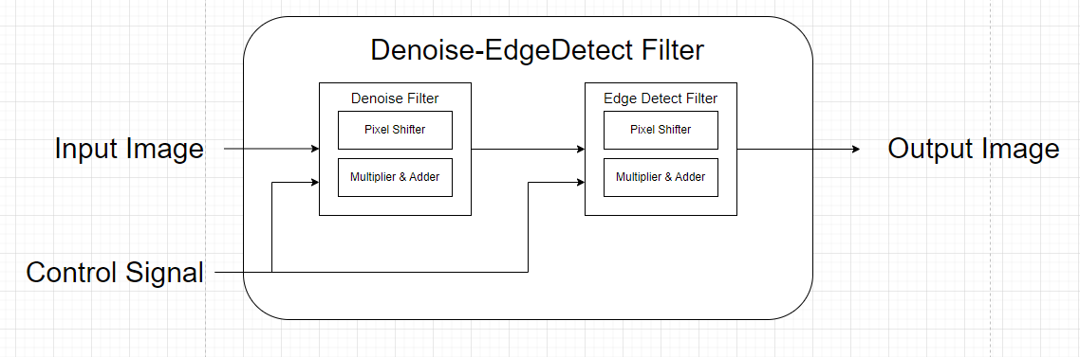
Catapult HLS
System Block
Denoise : Bypass、Gaussian Filter、Medium Filter
EdgeDetect : Bypass、Laplacian Filter、Sobel Filter
Pixel Shifter :Shifts the input image pixel
Multiplier & Adder : Performs mathematical operations to apply the kernel to the image pixel
Synthesis Report

Slide 4
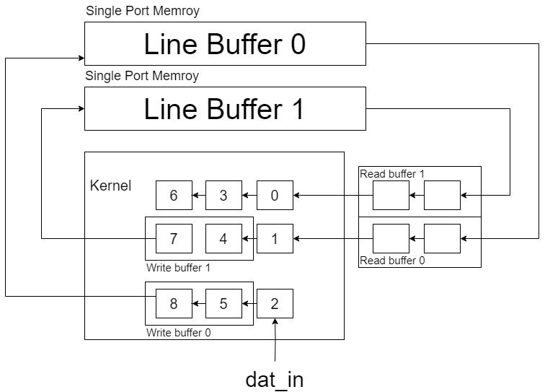
Catapult HLS
Pixel Shifter

Slide 5
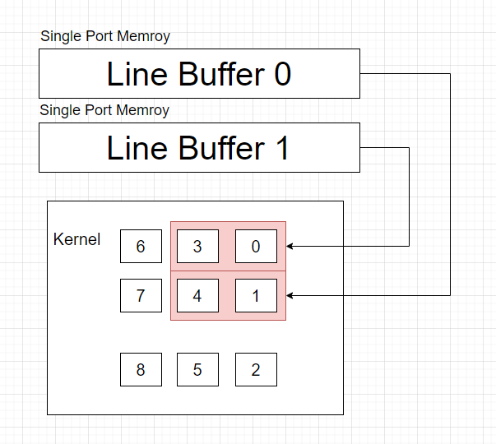
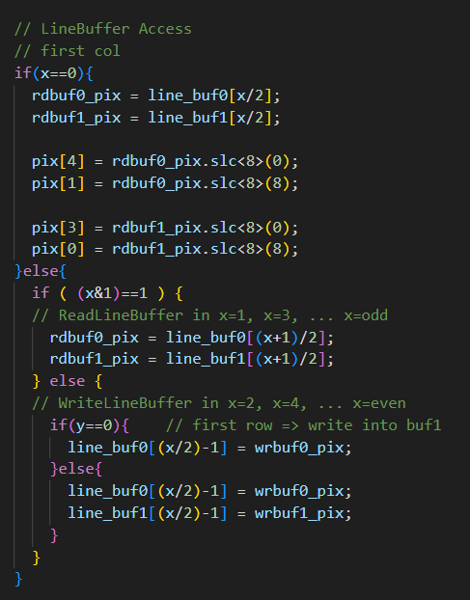
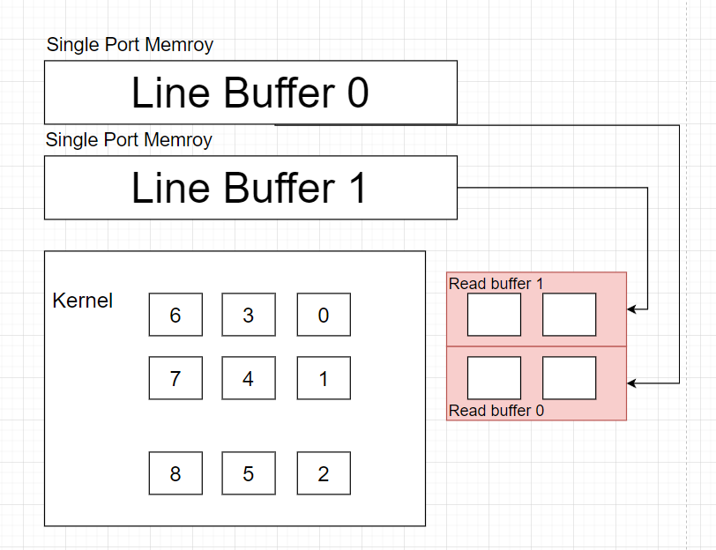
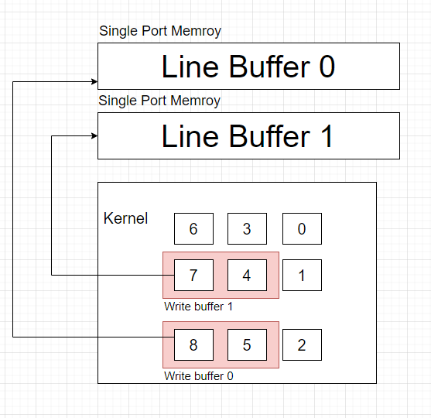
Catapult HLS
X=0
> Load Line buffer into kernel
Pixel Shifter – Line buffer access
X=1, 3, …, odd
> Load Line buffer into read buffer
X=2, 4, …, even
> Write back to line buffer

Slide 6
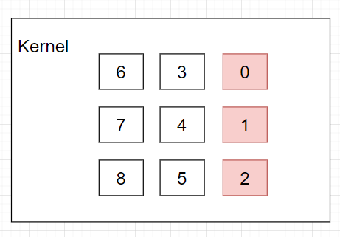
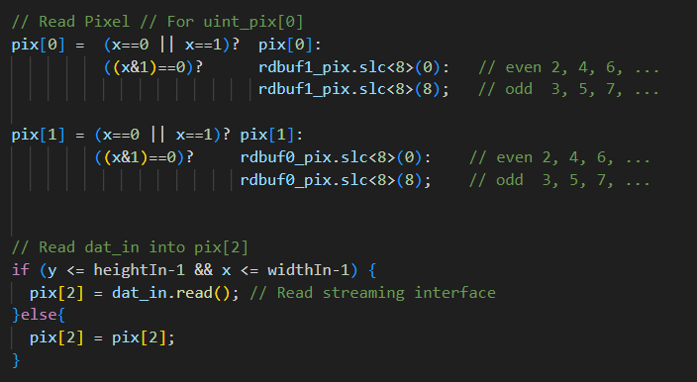
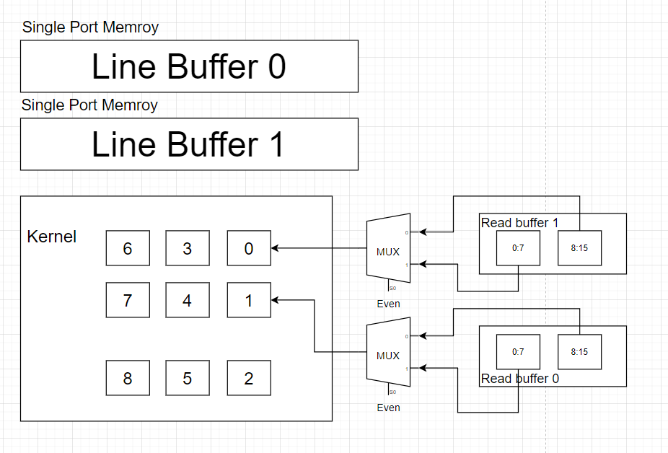
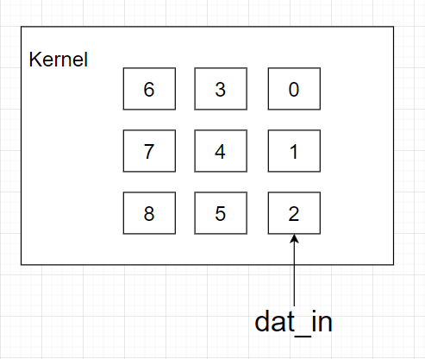
Catapult HLS
Pixel Shifter – Load pix0, pix1, pix2
X = 0 or 1> Remain the same
X = Even > load Read_buffer[0:7]
X = Odd > load Read_buffer[8:15]
Load dat_in into pix2

Slide 7
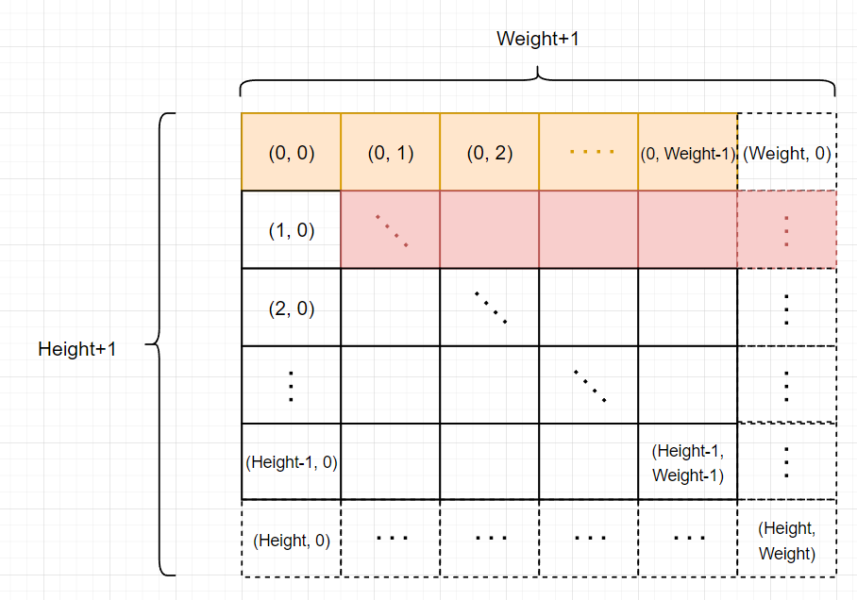
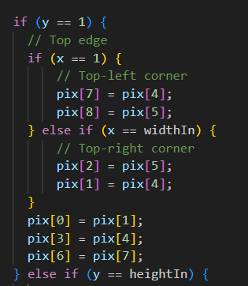
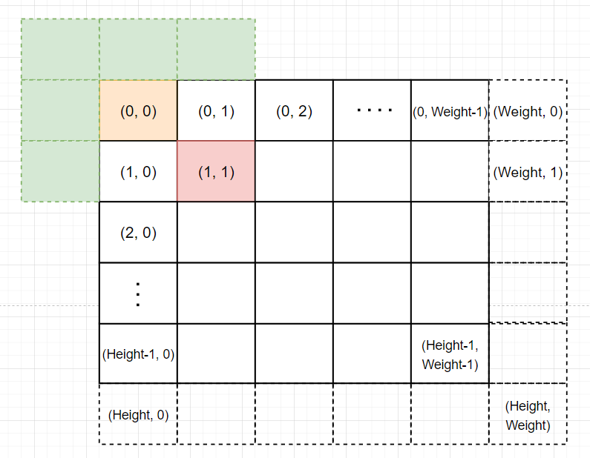
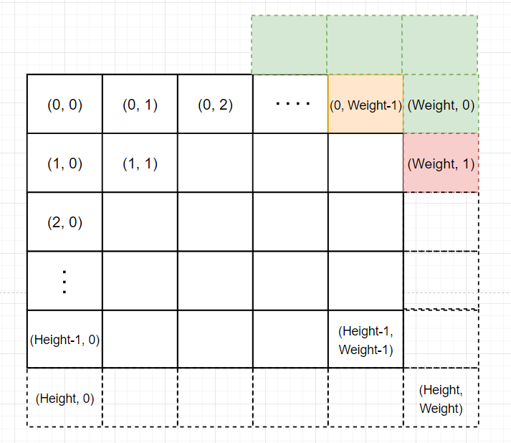
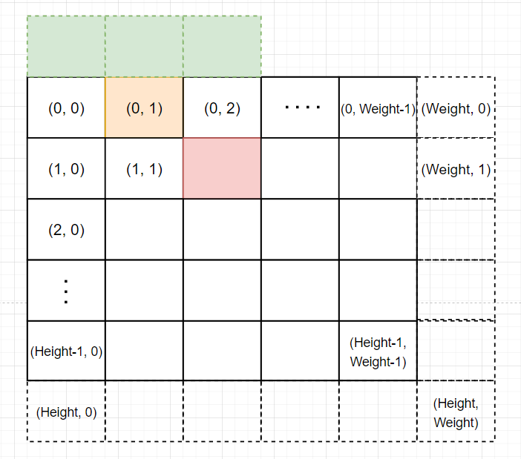
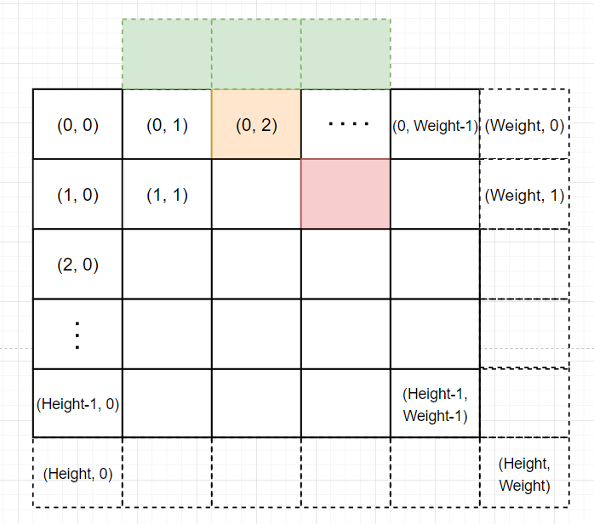
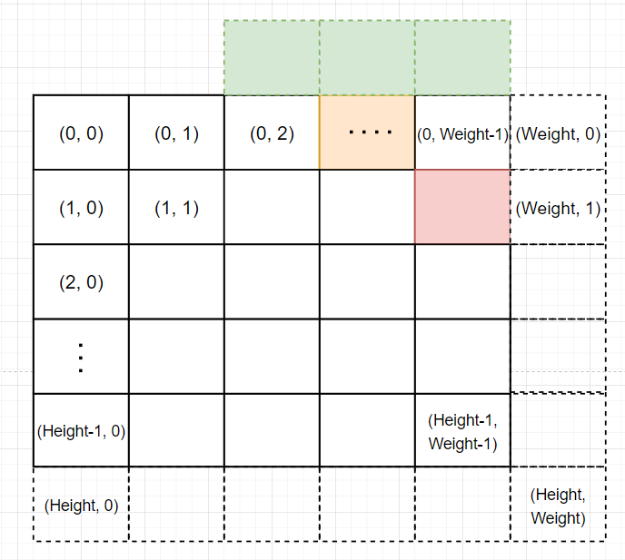
Green: Padding Pixel
Orange: Processing Pixel
Red: For loop idx (x, y)
Catapult HLS
Pixel Shifter - Padding
X=1, Y=1
X=Weight, Y=1
Determine if padding to the left(x==1) or right(x==widthIn) is needed.
Then, proceed with padding upwards.
Y=1

Slide 8
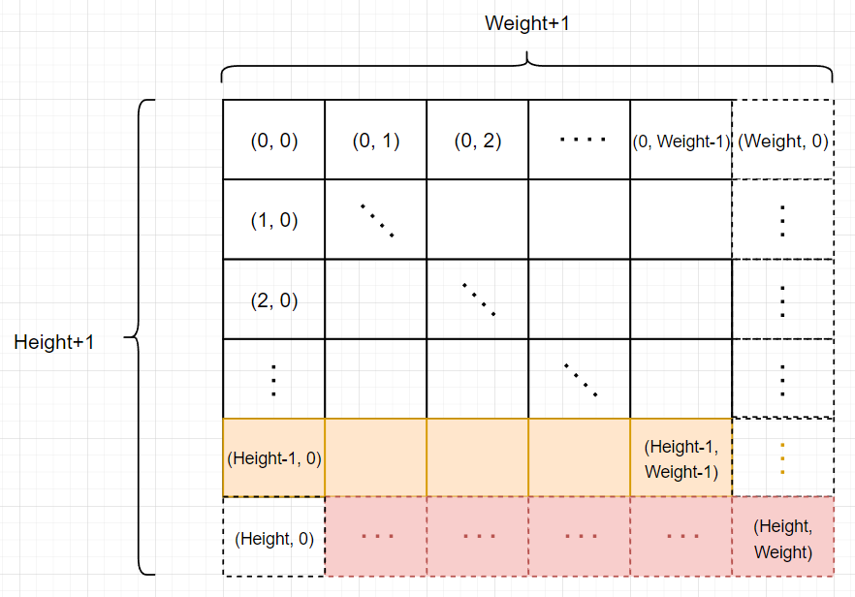
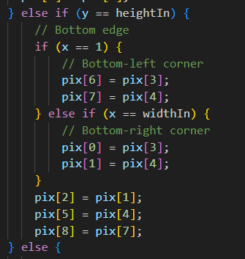
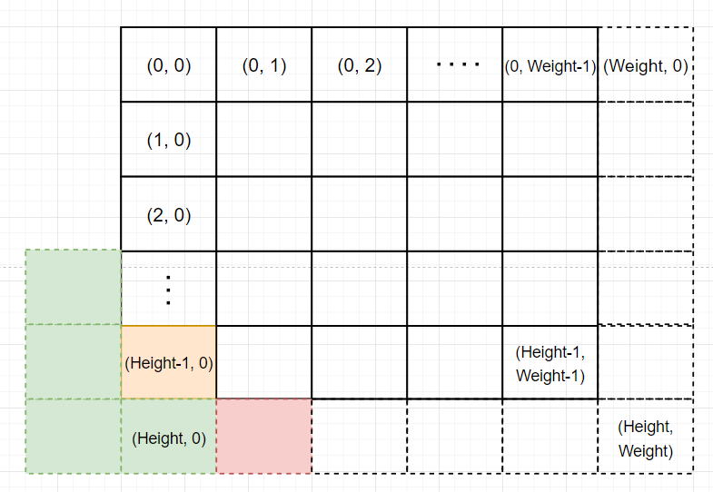
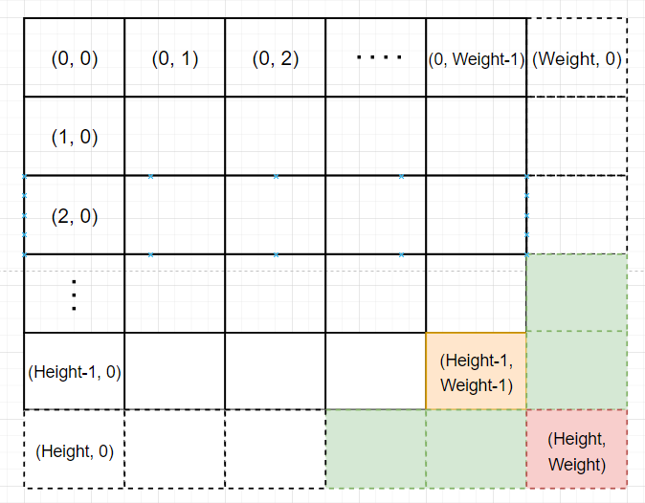
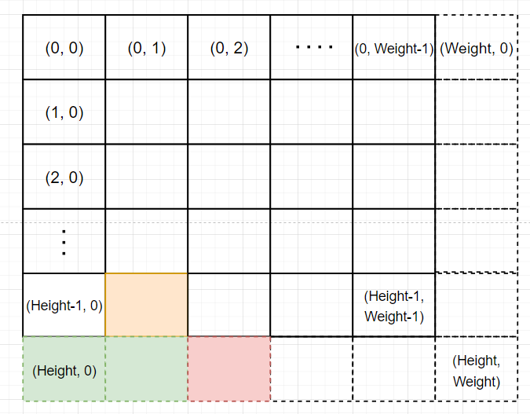
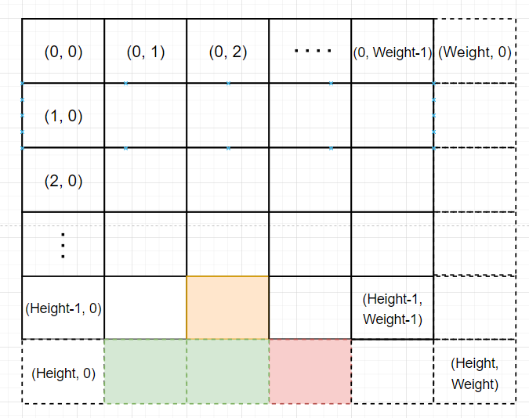
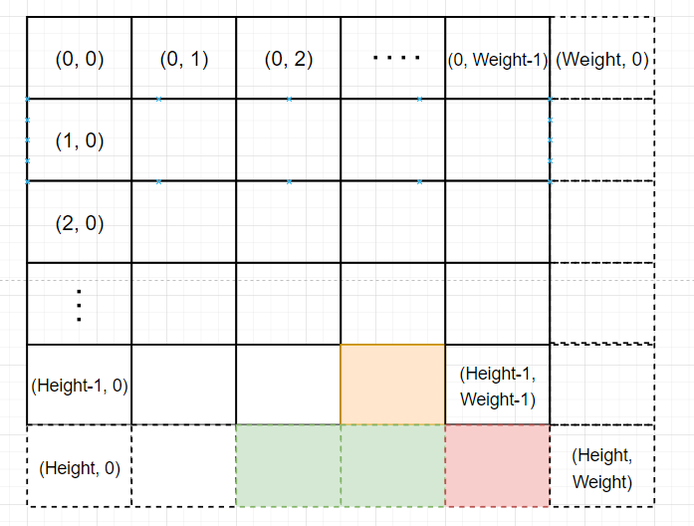
Green: Padding Pixel
Orange: Processing Pixel
Red: For loop idx (x, y)
Catapult HLS
Pixel Shifter - Padding
Y=Height, X=1
Y=Height,
X=Weight
Y=Height
Determine if padding to the left(x==1) or right(x==widthIn) is needed.
Then, proceed with padding downwards.

Slide 9
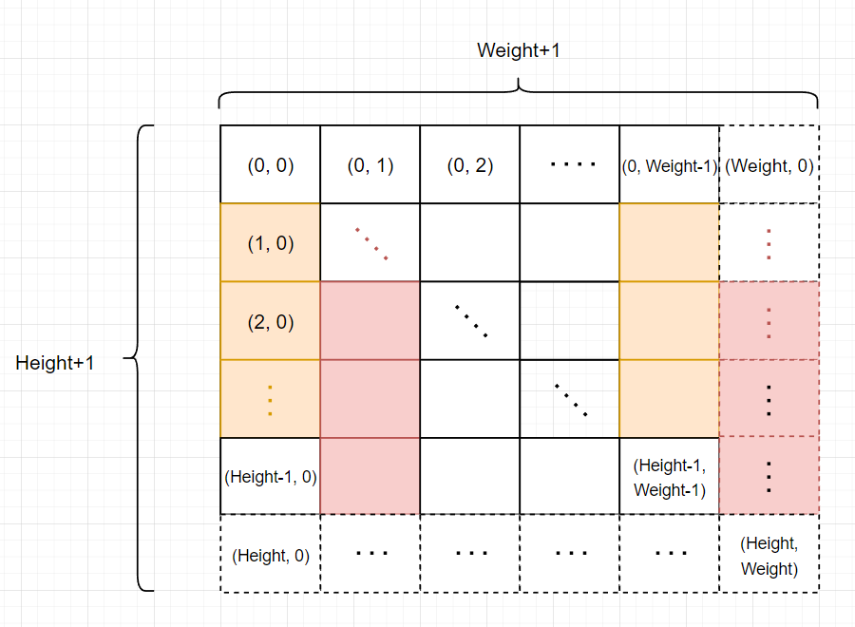
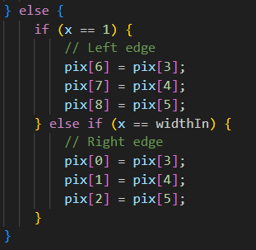
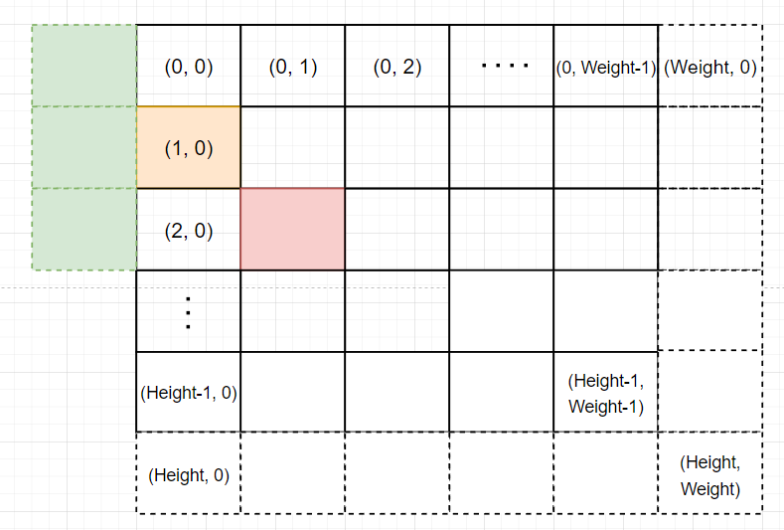
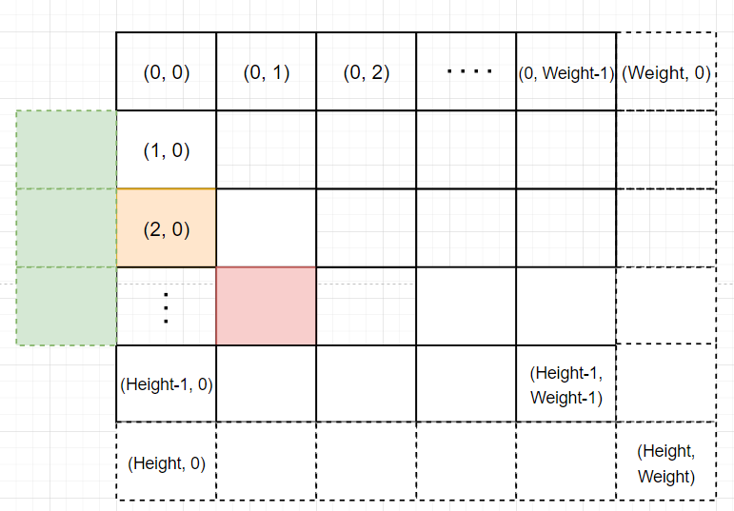
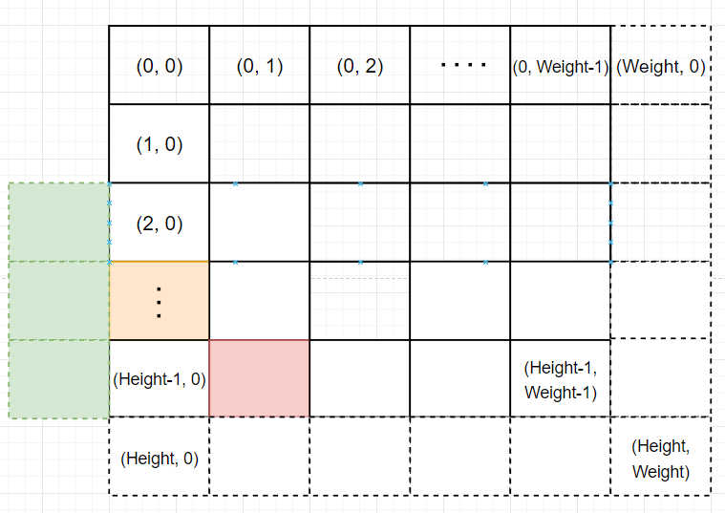
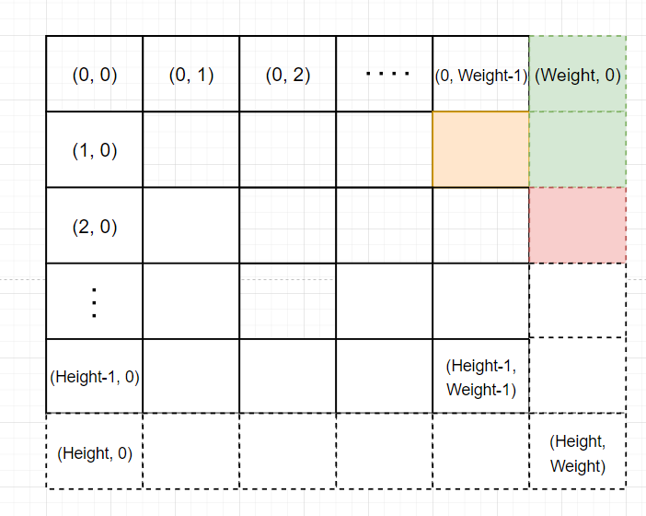
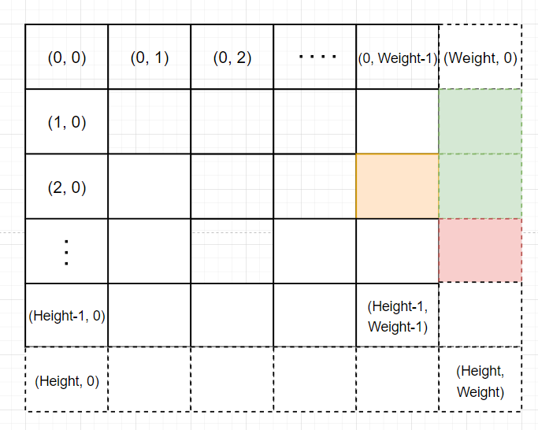
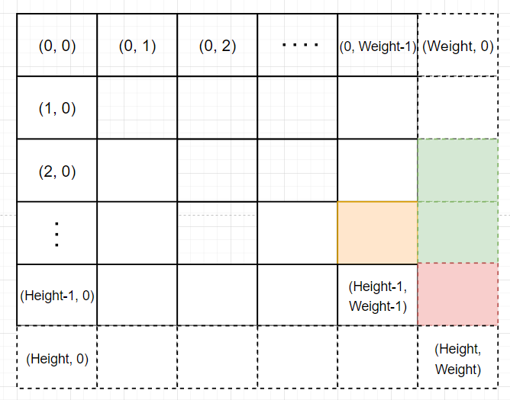
Green: Padding Pixel
Orange: Processing Pixel
Red: For loop idx (x, y)
Catapult HLS
Pixel Shifter - Padding
Padding left side
Padding right side

Slide 10
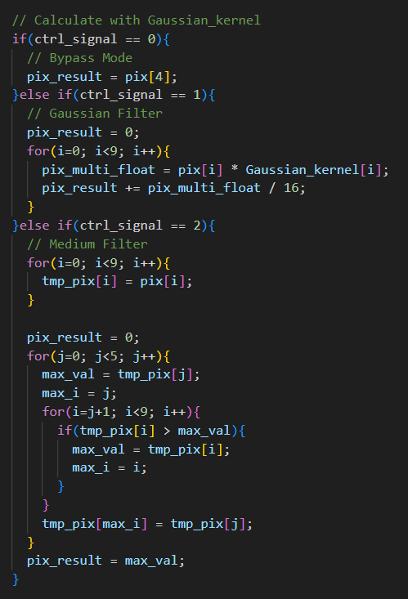
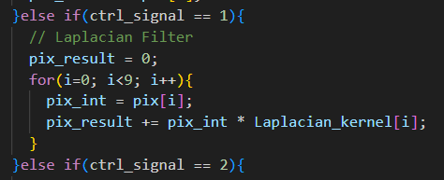
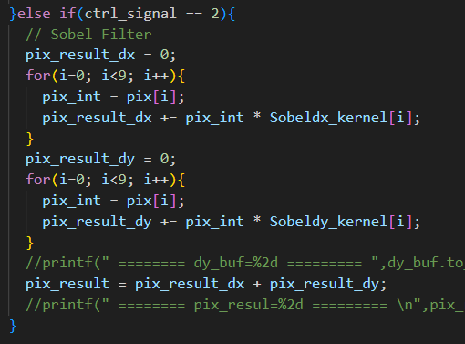
Catapult HLS
Multiplier & Adder – Calculate
Gaussian Filter
Laplacian Filter
Sobel Filter
Use one multiplier and one adder to finish the calculation

Slide 11
Catapult HLS
Multiplier & Adder – Calculate
Medium Filter
1. Starting from the jth position, find the maximum value between positions j+1 and END.
2. Once the maximum value is found, swap its position with the jth position to ensure that the values from j+1 to END are less than the value at the jth position
(since the values from 0 to jth are not used, there is no need to assign a new value to jth).
3. After five iterations, the maximum value will be the median of the array.

Slide 12
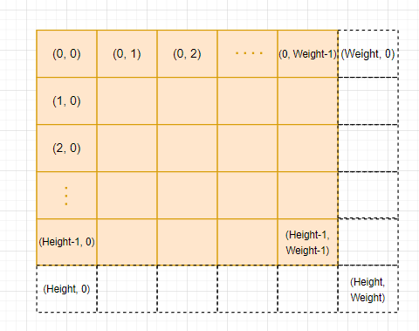
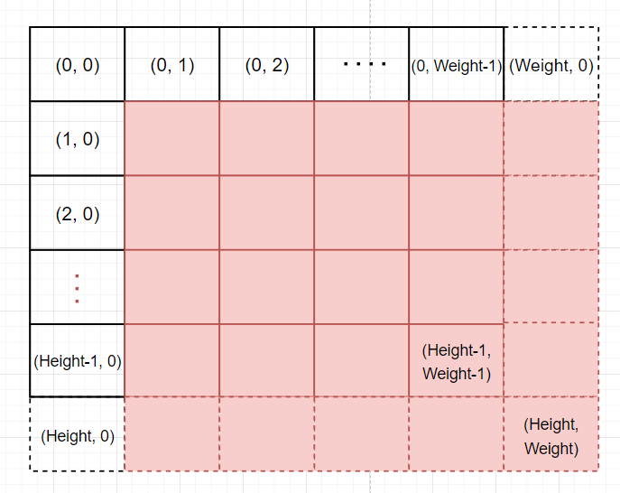
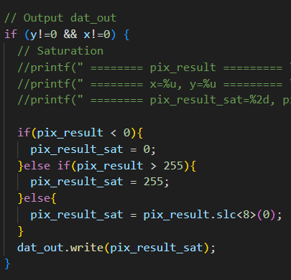
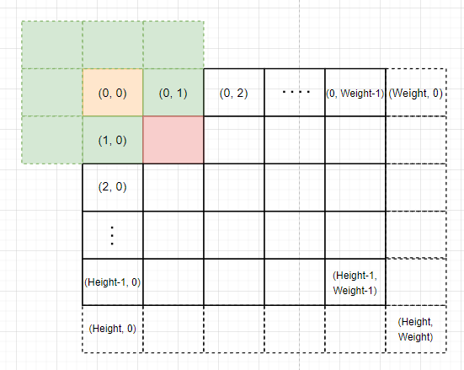
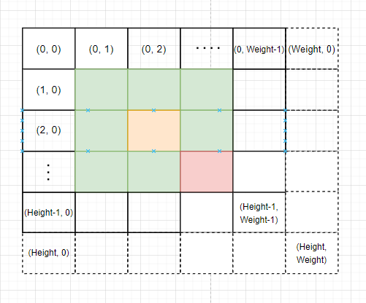
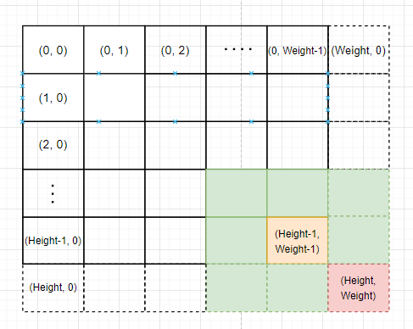
Catapult HLS
Pixel Shifter – Output
Image Pixel
Output the result when (x != 0 && y != 0)
Green: 3X3 Kernel
Orange: Processing Pixel
Red: For loop idx (x, y)

Slide 13
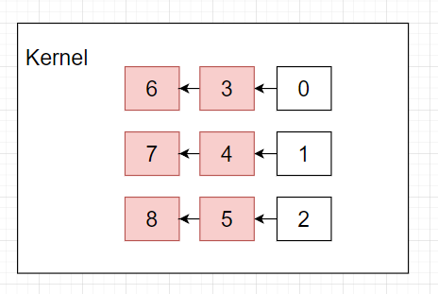
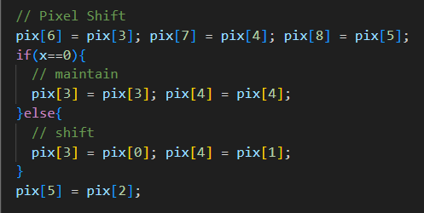
Catapult HLS
Pixel Shifter – Pixel Shift
When the output is complete, the pixels need to be shifted.
Next, load pix0, pix1, and pix2, and repeat the whole process.

Slide 14
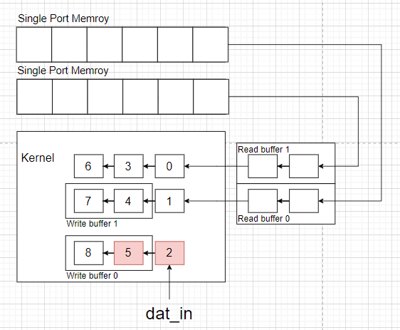
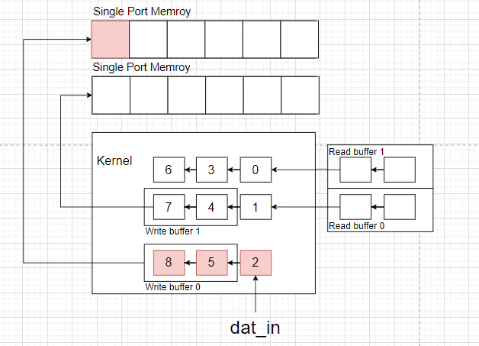
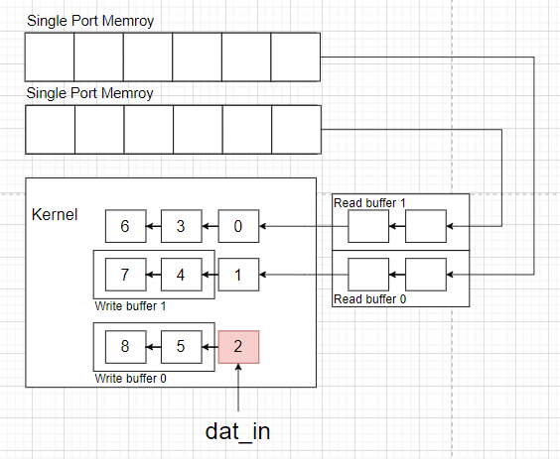
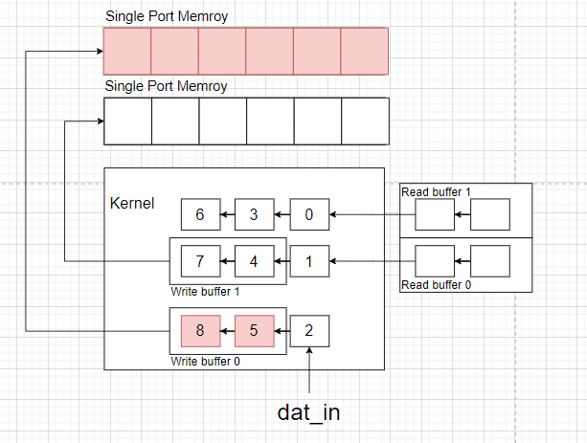
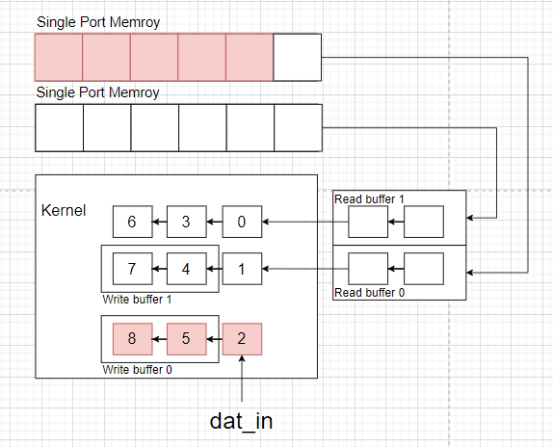
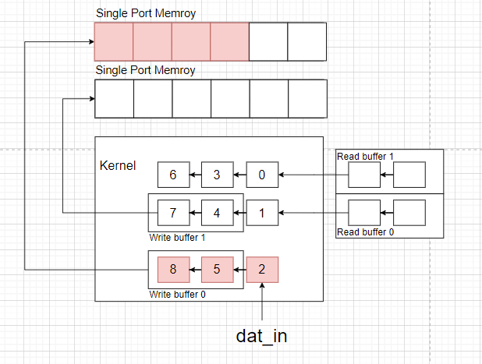
Catapult HLS
Y=0
X=0
X=1
X=2
X= Weight
X= Weight-1
X= …

Slide 15
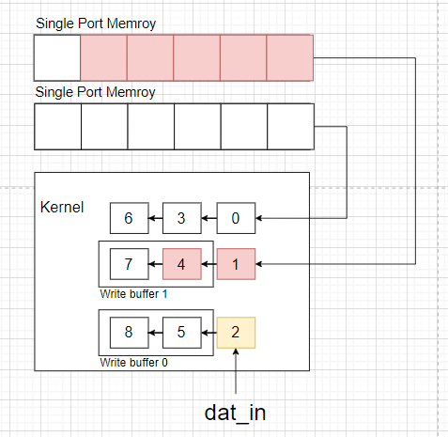





Catapult HLS
Y=1
X=0
X=1
X=2
X= Weight
X= Weight-1
X= …

Slide 16






Catapult HLS
Y=2
X=0
X=1
X=2
…
X= Weight
X= Weight-1
X= …

Slide 17






Catapult HLS
Y=Height
X=0
X=1
X=2
…
X= Weight
X= Weight-1
X= …

Slide 18



Catapult HLS
Result
Gaussian Filter
Image with Gaussian noise
Medium Filter

Slide 19



Catapult HLS
Result
Gaussian Filter
Image with SaltPepper noise
Medium Filter

Slide 20



Catapult HLS
Result
Laplacian Filter
Image with large edge variation
Sobel Filter

Slide 21



Catapult HLS
Result
Laplacian Filter
Image with small edge variation
Sobel Filter

Slide 22

Integrate into FSIC

Slide 23

Caravel-FSIC FPGA simulation
Flow

Slide 24

FSIC Testbench

Slide 25

FSIC Testbench

Slide 26

FSIC Testbench

Slide 27

FSIC Testbench

Slide 28

FSIC Testbench

Slide 29


FSIC Testbench

Slide 30









Result
Bypass Gaussian Medium
Bypass
Laplacian
Sobel

Slide 31

Caravel-FSIC FPGA Simulation Block Design

Slide 32

Caravel-FSIC FPGA Simulation

Slide 33


Caravel-FSIC FPGA Simulation

Slide 34

Caravel-FSIC FPGA Simulation

Slide 35

Caravel-FSIC FPGA Simulation

Slide 36

Caravel-FSIC FPGA Simulation

Slide 37

Caravel-FSIC FPGA Simulation

Slide 38

Caravel-FSIC FPGA Simulation

Slide 39
Result
Bypass Gaussian Medium
Bypass
Laplacian
Sobel

Slide 40


Synopsys flow
Synthesis
Screenshot
netlist

Slide 41



Synopsys flow
Planning
data_setup floorplan
powerplan

Slide 42


Synopsys flow
Placing and Clock synthesis
placing clock tree

Slide 43

Synopsys flow
Routing

Slide 44

Synopsys flow
starRC

Slide 45


Synopsys flow
Primetime

Slide 46



Caravel-FSIC FPGA validation
We successfully integrated the Caravel-FSIC FPGA, and it operates as expected.
Although the FPGA validation results matched the results from earlier simulations, they differed from the outcomes in the C_sim.
Input image with variation enhanced
Output of C_sim
Output of verilog sim and
FPGA validation

Slide 47
Caravel-FSIC FPGA simulation
Possible Cause The output from C_sim and validation appears different, revealing a potential issue with the line buffer usage in the Verilog code. Additionally, the color level range of the output is not as wide as the C_sim result. This inconsistency might result from the casting of floating-point values to integers during hardware computation.

Slide 48
Thank you

